Slide 1
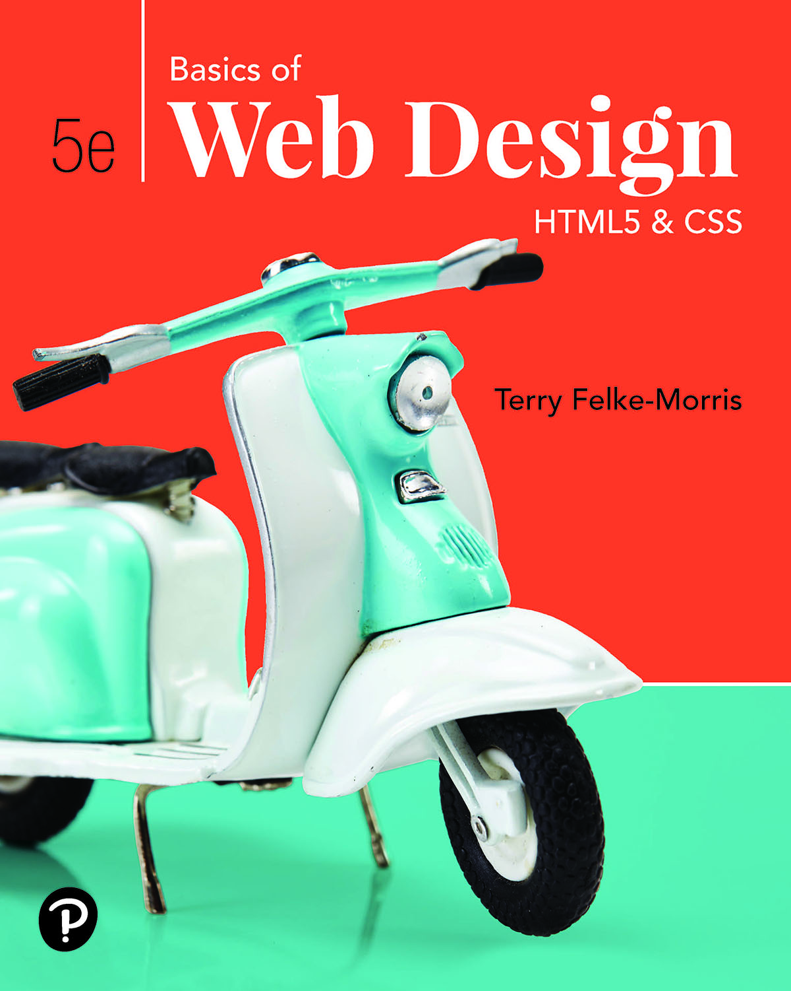
Basics of Web Design
Fifth Edition
Chapter 8
Responsive Layout Basics Key Concepts
Slide in this Presentation Contain Hyperlinks. JAWS users should be able to get a list of links by using INSERT+F7
Copyright © 2019 Pearson Education, Inc. All Rights Reserved
Notes:
If this PowerPoint presentation contains mathematical equations, you may need to check that your computer has the following installed:
1) Math Type Plugin
2) Math Player (free versions available)
3) NVDA Reader (free versions available)

Slide 2
Learning Outcomes
Describe the purpose of C S S Flexible Box Layout
Configure a web page that applies C S S Flexible Box Layout
Describe the purpose of C S S Grid Layout
Configure a grid container
Configure grid rows, grid columns, and grid gaps
Create responsive page layouts with C S S Grid Layout
Configure web pages for mobile display using the viewport meta tag
Apply responsive web design techniques with C S S media queries
Apply responsive image techniques including the new H T M L 5 picture element

Slide 3
C S S Flexible Box Layout aka flexbox
Purpose: Provide for a flexible, responsive layout https://www.w3.org/TR/css-flexbox-1/
Best used for one dimension – a row or a column
The display property
Configures a flexbox container
display: flex;
Flex Item -- a child element of the flex container
The flex-wrap property
Determines whether flex items are displayed on multiple lines
Values are nowrap (default), wrap, wrap-reverse
The flex-direction property
Configures the flow direction
Values are row,(default), column, row-reverse, and column-reverse

Slide 4
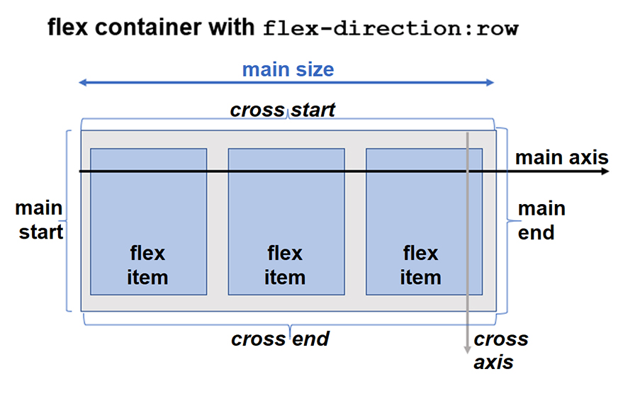
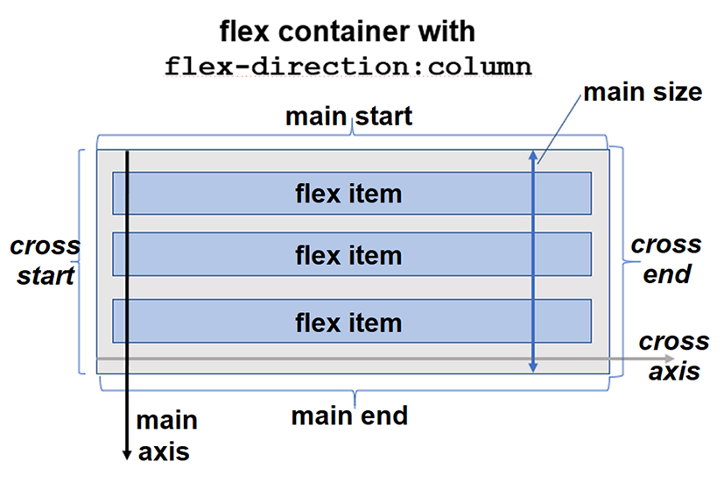
Diagram of a Flex Container

Slide 5
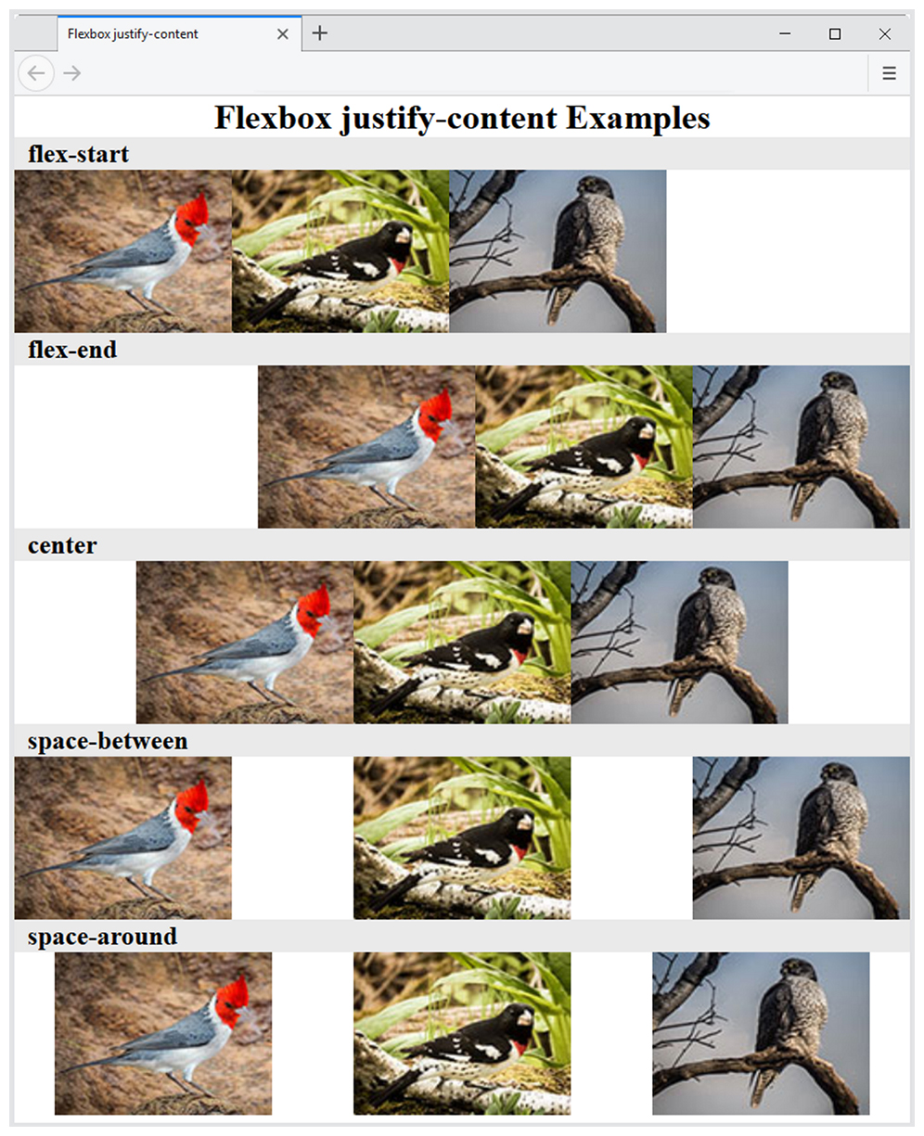
The justify-content Property
Configures how the extra space along the main axis should be displayed

Slide 6
More flexbox Properties
The align-items Property
Configures how the browser displays extra space along the cross-axis
The flex-flow Property
Shorthand to configure flex-direction and flex-wrap properties
The order Property
Causes the browser to display flex items in different order than they are coded
Warning – this could be an accessibility issue

Slide 7
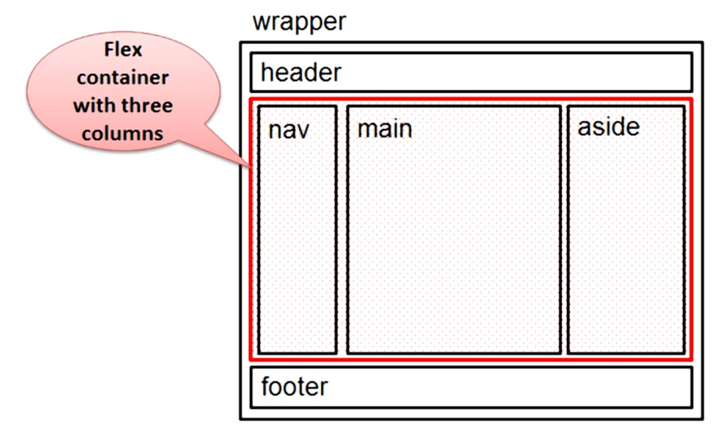
Configure Flex Items
By default flex items are flexible in size and allocated the same amount of space in the flex container
The flex property
Customizes the size of each flex item
Indicated the flex grow factor
Indicates the flex shrink factor
Can be used to indicate a proportional flexible item
nav { flex: 1; }
main { flex: 7; }
aside { flex: 2; }

Slide 8
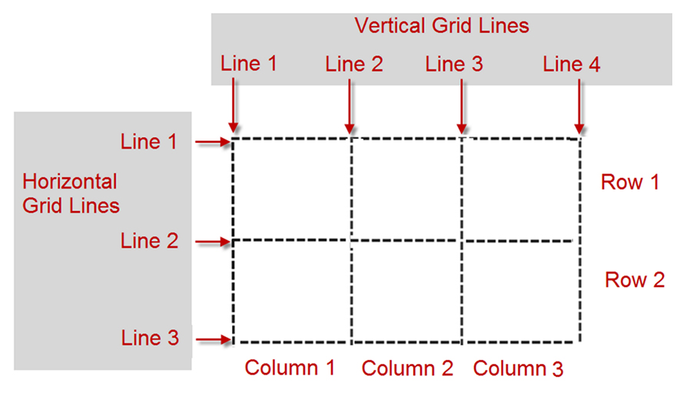
C S S Grid Layout
Purpose: Configure a two-dimensional grid-based layout
The grid can be fixed in dimension or flexible and responsive. https://www.w3.org/TR/css-grid-1/
The display property
Configures a grid container
display: grid;
Grid Item -- a child element of the grid container
Grid Terms
Grid line
Grid row
Grid column
Grid track
Grid gap
The order property

Slide 9
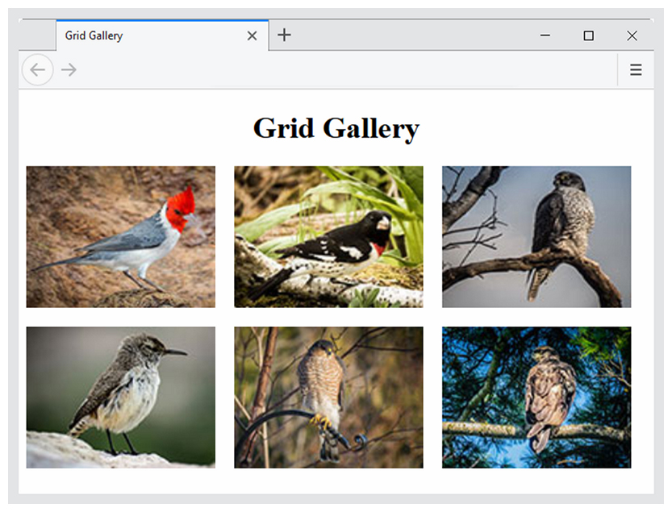
Configure Grid Columns and Grid Rows
The grid-template-columns property
The grid-template-rows property
Example:
#gallery { display: grid;
grid-template-columns: 220px 220px 220px;
grid-template-rows: 170px 170px; }

Slide 10
Grid Columns & Grid Rows
https://www.w3.org/TR/css-grid-1/#propdef-grid-template-columns
Commonly used values for grid-template-columns and grid-template-rows
Value | Description
numeric length unit | Configures a fixed size with a length unit such as px or em Example: 220px
numeric percentage | Configures a percentage size; Example: 20%
numeric fr unit | Configures a flex factor unit (denoted by fr) that directs the browser to allocate a fractional part of the remaining space
auto | Configures a size to hold the maximum content
minmax (min, max) | Configures a size range greater or equal to min value and less than or equal to max value. The max can be set to a flex factor.
repeat(repetition amount, format value) | Repeats the column or row the number of times specified by the repetition amount numeric value or keyword and uses the format value to configure the column or row. The auto-fill keyword indicates to repeat but stop before an overflow. Example: repeat (autofill, 250px)

Slide 11
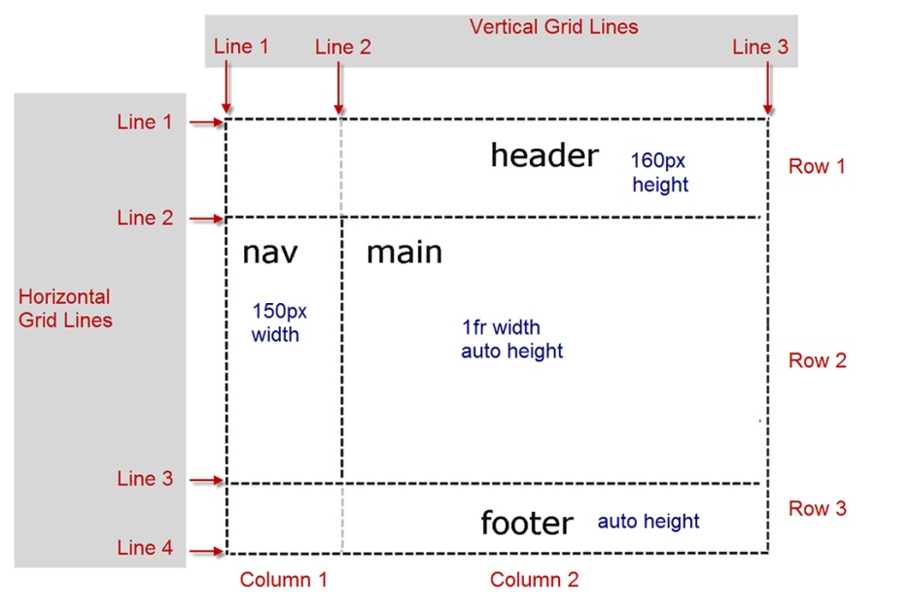
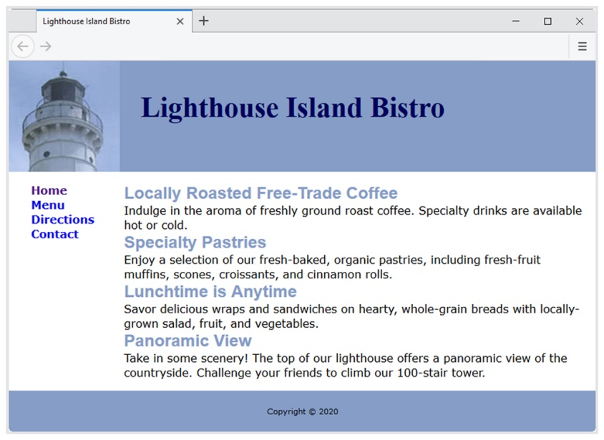
Configure Grid Items
The grid-row property
configures the area in rows that is reserved for the item in the grid
The grid-column property
configures the area in columns that is reserved for the item in the grid
Grid Line Numbers
Identify the starting and ending line number separated by a / character
header { grid-row: 1 / 2; grid-column: 1 / 3; }
nav { grid-row: 2 / 3; grid-column: 1 / 2; }
main { grid-row: 2 / 3; grid-column: 2 / 3; }
footer { grid-row: 3 / 4; grid-column: 1 / 3; }

Slide 12
Progressive Enhancement with Grid
C S S Feature Query
A feature query is a conditional that can be used to test for support of a C S S property, and if support is found, apply the specified style rules.
@supports ( display: grid) {
…. grid styles go here …
}
Progressive Enhancement Strategy
Configure web page layout with normal flow or float for browsers and devices that do not support grid
Configure a feature query with grid layout for modern browsers

Slide 13
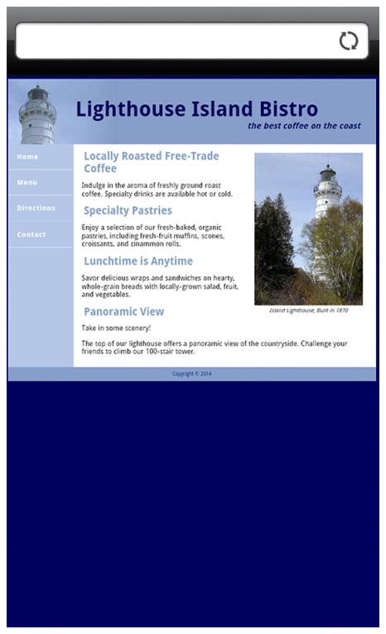
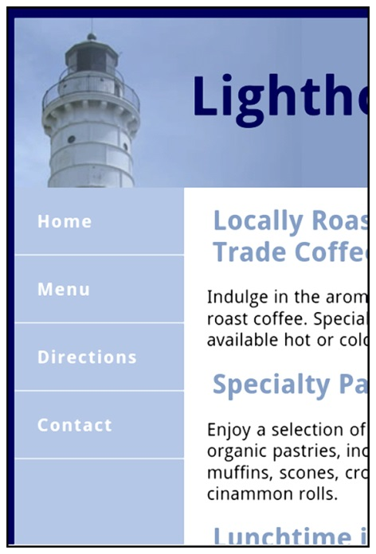
Viewport Meta Tag
Default action for most mobile devices is to zoom out and scale the web page
Viewport Meta Tag
Created as an Apple extension to configure display on mobile devices
Configures width and initial scale of browser viewport
<meta name="viewport" content="width=device-width, initial-scale=1.0">

Slide 14
Telephone & Text Message Hyperlinks
Telephone Scheme
<a href="tel:888-555-5555">Call 888-555-5555</a>
Many mobile browsers will initiate a phone call when the hyperlink is clicked.
S M S Scheme
<a href="sms:888-555-5555">Text 888-555-5555</a>
Many mobile browsers will initiate a text message to the phone number when the hyperlink is clicked.

Slide 15
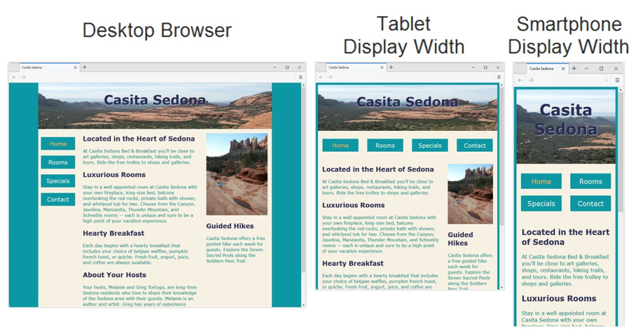
Responsive Web Design
Term coined by Ethan Marcotte
Progressively enhancing a web page for different viewing contexts
Techniques:
Fluid Layout
C S S Media Queries
Flexible Images

Slide 16
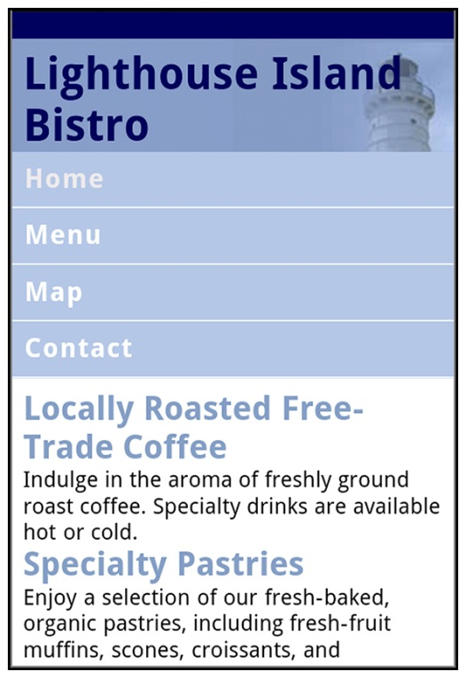
C S S 3Media Queries
Media Query
Determines the capability of the mobile device, such as screen resolution
Directs the browser to styles configured specifically for those capabilities
Link Element Example:
<link href="lighthousemobile.css" media="only screen and (max-device-width: 480px)">
C S S Example:
@media only screen and (max-width: 480px) {
header { background-image: url(mobile.gif);
}
}

Slide 17

Flexible Images
Edit H T M L:
remove height and width attributes
C S S:
img { max-width: 100%;
height: auto; }

Slide 18
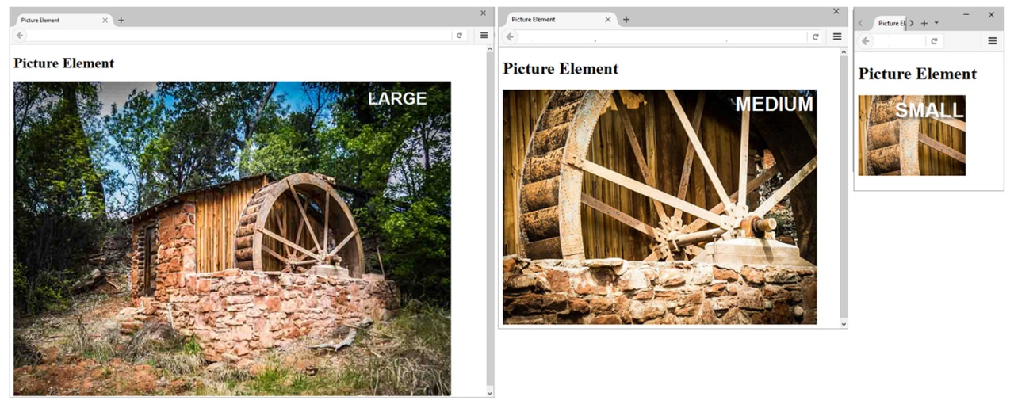
Responsive Images H T M L 5.1 Picture Element
<picture>
<source media="(min-width: 1200px)" srcset="large.jpg">
<source media="(min-width: 800px)" srcset="medium.jpg">
<source media="(min-width: 320px)" srcset="small.jpg">
<img src="fallback.jpg" alt="waterwheel">
</picture>

Slide 19

Responsive Images H T M L 5.1 sizes & srcset Attributes
<img src="fallback.jpg"
sizes="100vw"
srcset="large.jpg 1200w, medium.jpg 800w, small.jpg 320w"
alt="waterwheel">

Slide 20
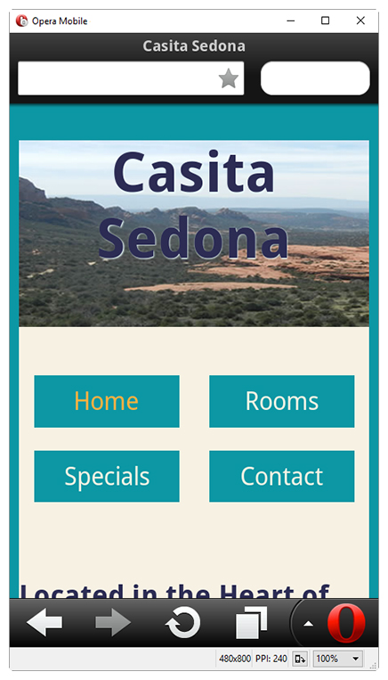
Testing Mobile Display Options
Test with a mobile device
Emulators
Opera Mobile Emulator
Mobilizer
Opera Mini Simulator
iPhone Emulator
Test with a Desktop Browser
Install an i O S or Android S D K

Slide 21
C S S Debugging Tips
Manually check syntax errors
Use W 3 C C S S Validator to check syntax errors
http://jigsaw.w3.org/css-validator/
Configure temporary background colors
Configure temporary borders
Use C S S comments to find the unexpected
/* the browser ignores this code */
Don’t expect your pages to look exactly the same in all browsers!
Be patient!

Slide 22
Summary
This chapter expanded your C S S and H T M L skillset.
You configured web pages with C S S Flexible Box Layout (flexbox).
You configured web pages with C S S Grid Layout.
You configured web pages for mobile display using the viewport meta tag.
You applied responsive web design techniques with C S S media queries and feature queries.
You applied responsive image techniques including the picture element.
You explored techniques for testing the mobile display of a web page.

Slide 23

Copyright
This work is protected by United States copyright laws and is provided solely for the use of instructors in teaching their courses and assessing student learning. Dissemination or sale of any part of this work (including on the World Wide Web) will destroy the integrity of the work and is not permitted. The work and materials from it should never be made available to students except by instructors using the accompanying text in their classes. All recipients of this work are expected to abide by these restrictions and to honor the intended pedagogical purposes and the needs of other instructors who rely on these materials.

